Slide 1
In plate number, “plate” is the noun and “number” is supposedly the adjective. But that doesn’t sound plausible–only adjectives describe nouns.

Slide 2
It is common knowledge that an adjective describes a noun. In this case, number is the adjective, and plate is the noun. Since it is the plate that bears the number—not the other way around—the correct expression is number plate.

Slide 3
It is not plate number but number plate.

Slide 5
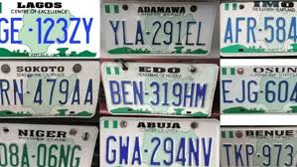
IS IT PLATE NUMBER?

Slide 6
In conclusion, unlike some Nigerian expressions such as buka, bukateria, japa, agbero, cross-carpet, area boy, and 419 which have now entered the English dictionary, plate number has not.

Slide 7


Slide 8


Slide 9
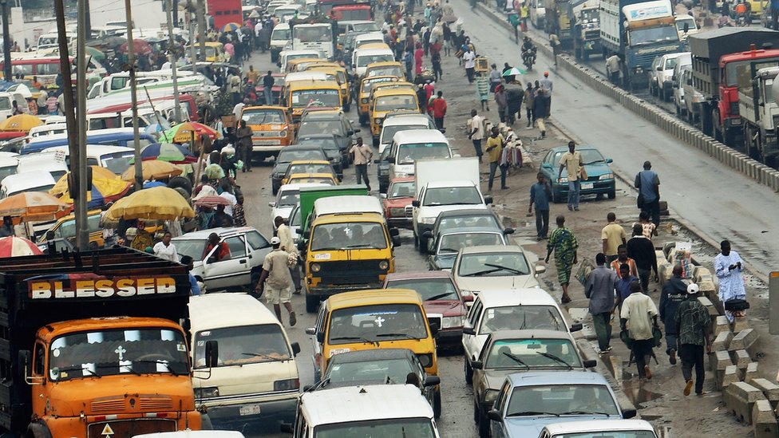

Slide 10


Slide 11
